Slide 1
Ideation

Slide 2

ideation
https://media.nngroup.com/media/articles/attachments/Design-thinking-101-NNG.pdf

Slide 3
ideation
https://media.nngroup.com/media/articles/attachments/Design-thinking-101-NNG.pdf

Slide 4
ideation
https://media.nngroup.com/media/articles/attachments/Design-thinking-101-NNG.pdf

Slide 5
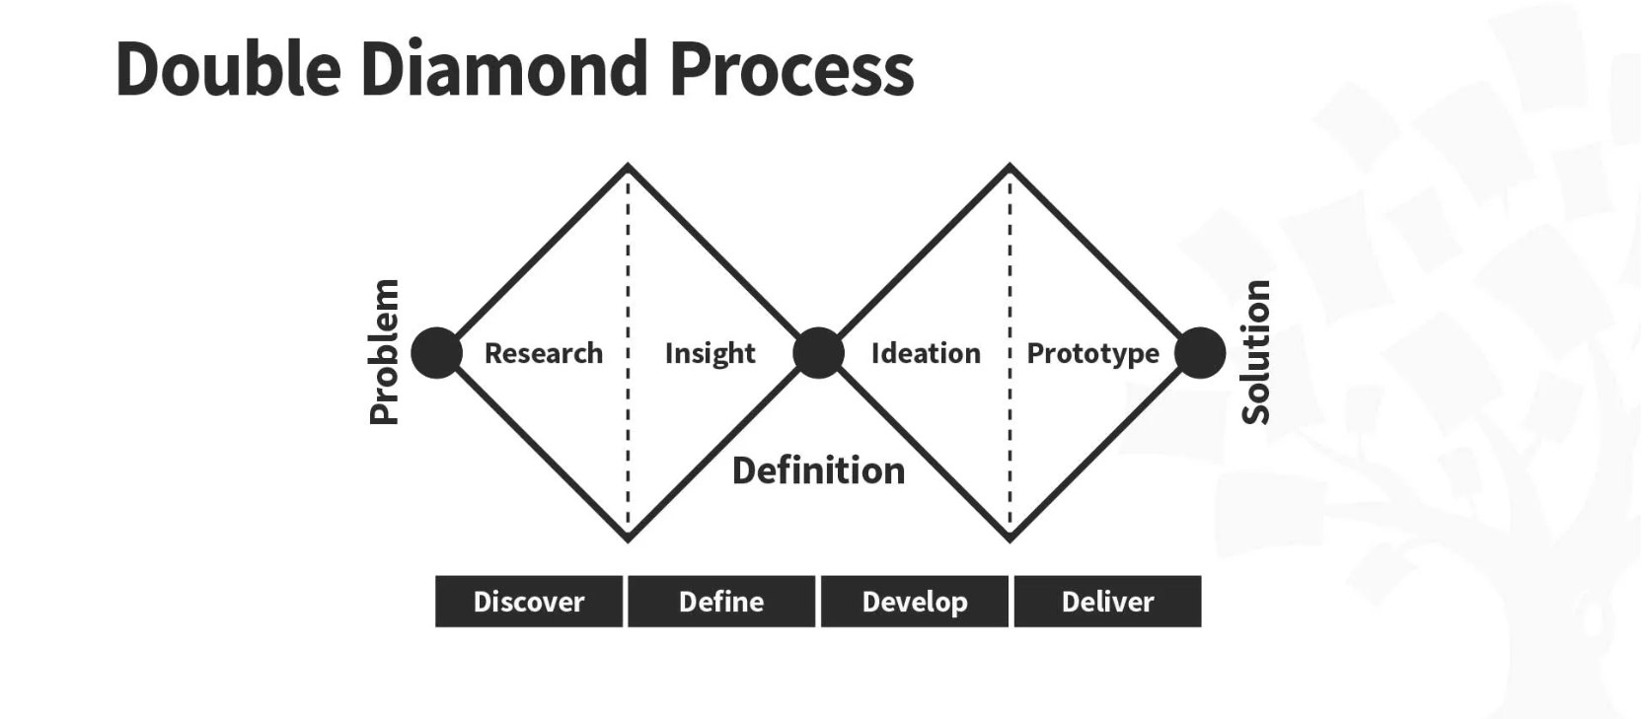
ideation
https://www.interaction-design.org/

Slide 6
ideation
1. Create the right type of environment
be creative
are you curious?
feel safe

Slide 7
ideation
2. Ensure all participants are viewed as equals

Slide 8
ideation
3. Set targets
Let’s make 50 ideas in 20 minutes!
Let’s fill out the entire sheet before the break!

Slide 9
ideation
4. Make sure your team views ideation in a positive light
No!

Slide 10
ideation
Group work
Have your “how might we” (HMW) questions ready
Choose ideation methods to try
Consider a change of scenery
Pick a facilitator for keeping time etc. (groups of >=3)
Pick a “bad designer”
Pick a “good designer”
Remember to document everything!

Slide 11
FIN

